Slide 1
ML-Based Classification of Digitally Modulated Signals
23AIE233M
Vijay Venkatesan V
CB.EN.U4ECE22058

Slide 2
Table of Contents
Introduction
Traditional Classification
Advantages of Using Machine Learning
Incorporating Machine Learning into Modulation Classification
Benefits of Machine Learning in Modulation Classification
Current Problems and Challenges
Conclusion

Slide 3
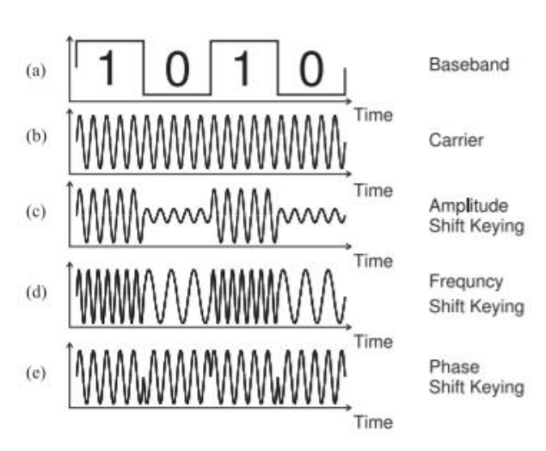
Introduction
Digitally modulated signals are a crucial component of modern communication systems, facilitating the transmission of data over various mediums.
These signals represent digital information by modulating an analog carrier wave using various schemes such as Phase Shift Keying (PSK), Amplitude Shift Keying (ASK), Frequency Shift Keying (FSK), and Quadrature Amplitude Modulation (QAM).
Each modulation technique alters a distinct attribute of the carrier wave—whether phase, amplitude, or frequency—to encode information.
As the digital world expands, classifying these modulation schemes accurately becomes essential for ensuring communication reliability, especially in applications like wireless communication, military, espionage, and bandwidth management.

Slide 4
Traditional Classification
Traditionally, the classification of digitally modulated signals was performed using feature extraction techniques and statistical models. Methods such as likelihood-based classification and cyclostationary analysis are two of the most common approaches.
Likelihood-Based Classification: This method relies on comparing the observed signal with theoretical models using likelihood functions. It provides accurate results but often requires extensive knowledge of channel parameters and high computational power, making it difficult to apply in real-time environments.
Cyclostationary Analysis: This technique leverages the periodicity in statistical properties of modulated signals to identify patterns. While robust, it is computationally heavy and not always effective in low signal-to-noise ratio (SNR) environments
Both approaches are limited by their dependency on accurate prior knowledge of signal characteristics, making them less flexible in rapidly changing environments. The need for advanced methods that can work efficiently in noisy and unpredictable conditions has driven the shift towards machine learning (ML)-based techniques. .

Slide 5
Advantages of Using Machine Learning
Machine learning introduces a transformative approach to modulation classification by learning directly from data, making it more adaptable and robust than traditional techniques.
Automated Feature Extraction: ML models, particularly deep learning, can automatically identify and learn essential features from raw signals, eliminating the need for manually selecting signal parameters. This automation reduces human error and enhances classification accuracy.
Generalization in Noisy Environments: ML algorithms, especially neural networks, have the ability to generalize patterns from training data, making them resilient to noise and other distortions in real-world communication channels.
Real-Time Processing: With modern advancements in hardware, machine learning algorithms can be implemented in real-time systems, ensuring faster and more accurate modulation detection, which is critical in dynamic communication scenarios like electronic warfare and spectrum monitoring.

Slide 6
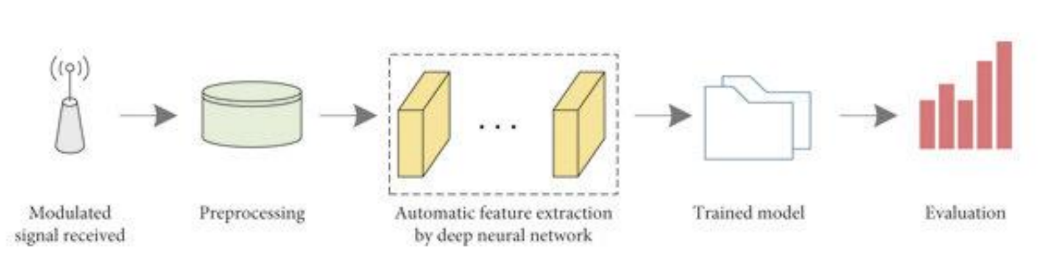
Incorporating Machine Learning into Modulation Classification
Incorporating machine learning into modulation classification offers several approaches to improve accuracy and robustness. Common techniques involve preprocessing the received signals and representing them through IQ components or time-frequency representations. From here, machine learning models such as K-Nearest Neighbors (KNN), Convolutional Neural Networks (CNNs), and Recurrent Neural Networks (RNNs) can be employed, with CNNs excelling in feature extraction and RNNs in capturing temporal dependencies

Slide 7
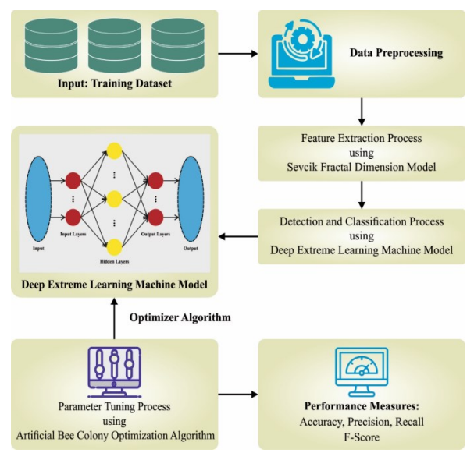
ADMSR
One of the most effective approaches is the Automatic Digital Modulation Scheme Recognition (ADMSR) method. ADMSR combines both handcrafted features and deep learning techniques, enhancing performance even under low SNR conditions. It incorporates additional steps such as
Advanced Feature Extraction: ADMSR goes beyond traditional IQ components by including features like high-order cumulants and cyclostationary properties, offering deeper insights into signal characteristics.
Hybrid Classifier Models: A fusion of traditional classifiers (KNN, SVM) and deep learning networks (CNN, LSTM) ensures the system captures both manually engineered and automatically learned features.
SNR Adaptability: ADMSR's SNR-aware models adapt to varying signal qualities, applying different classifiers based on the SNR level to optimize performance.
Optimization Techniques: ADMSR utilizes advanced optimization strategies such as metaheuristic algorithms (genetic algorithms, particle swarm optimization) alongside gradient descent to fine-tune model parameters and improve classification accuracy.

Slide 8
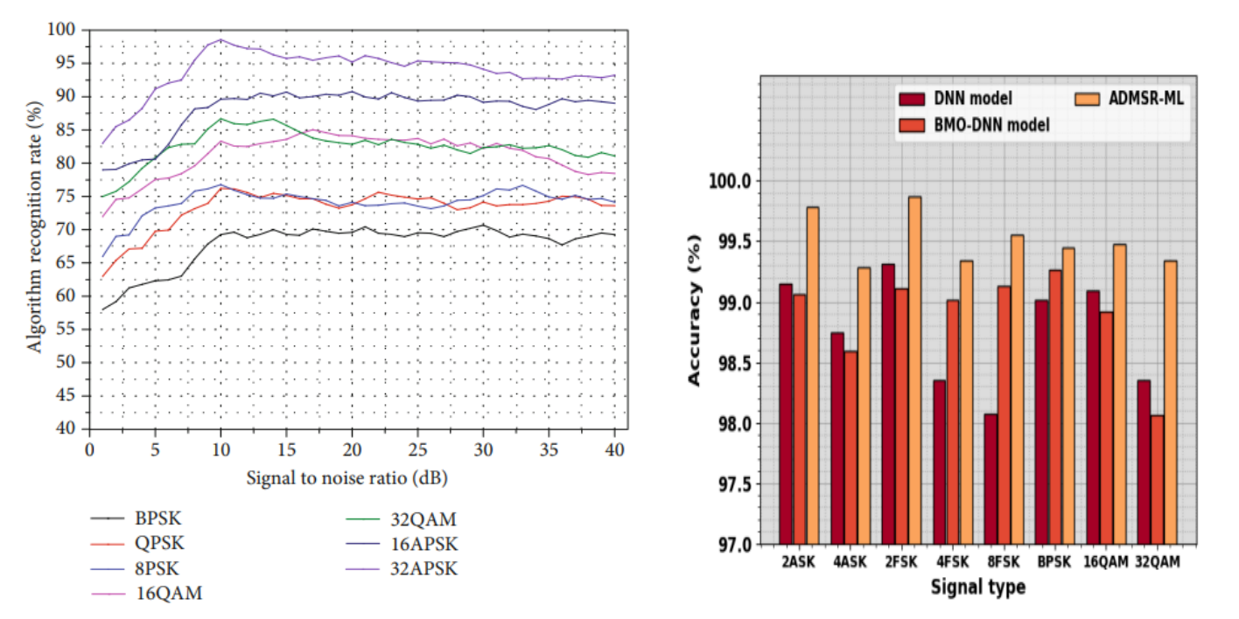
Benefits of Machine Learning
Higher Accuracy: Often achieve higher accuracy in modulation classification tasks compared to traditional methods. Their ability to automatically learn from data enables them to detect subtle patterns in signals, leading to better classification performance.
Adaptability: Easily adapted to classify new or unknown modulation types by retraining or fine-tuning the model with new data, without needing manual intervention or extensive redesign of the classification process.
Resilience to Noise: By training models on noisy datasets, they become more robust to signal distortions and interference, which is critical for real-world applications

Slide 9
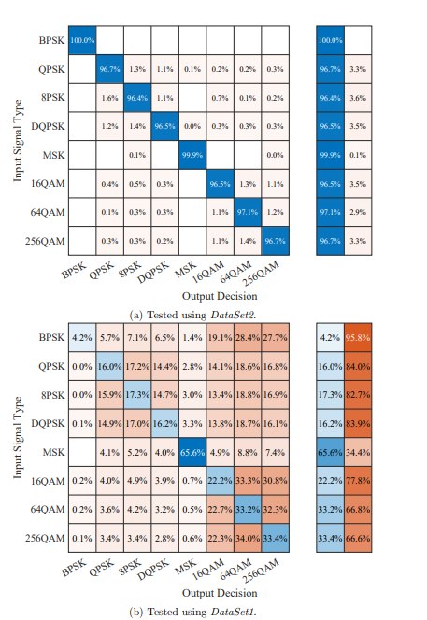
Current Problems and Challenges
Complexity and Computation: Deep learning models can be computationally expensive to train and deploy, especially in real-time applications where hardware limitations exist. The use of advanced hardware such as GPUs or specialized processors can mitigate this but adds to system cost.
Generalization: While ML models can generalize well from training data, there is always a risk of overfitting. Models that perform well on a particular dataset may not generalize as effectively to new or unseen modulation schemes or environments with different noise characteristics.
Interpretability: ML models, particularly deep neural networks, function as black boxes, making it difficult to interpret how they classify signals. This lack of transparency can be problematic in critical applications where understanding the decision-making process is important.

Slide 10
Conclusion
The application of machine learning to classify digitally modulated signals offers a promising alternative to traditional methods, with benefits including higher accuracy, scalability, and resilience to noise. However, challenges like the need for large datasets, computational resources, and model interpretability must be addressed for widespread adoption. As technology continues to evolve, combining ML with traditional approaches may provide an optimal solution for accurate and efficient modulation classification in various communication systems.
REFERENCES
Automated Digitally Modulated Signal Recognition and Classification using Machine Learning with Multimodal.https://ieeexplore.ieee.org/stamp/stamp.jsp?tp=&arnumber=10250687
Latshaw, J.A., Machine Learning Classification of Digitally Modulated Signals, Old Dominion University, 2022
Huang, Z., Li, C., Lv, Q., Su, R., Zhou, K., Automatic Recognition of Communication Signal Modulation Based on the Multiple-Parallel Complex Convolutional Neural Network, Wireless Communications and Mobile Computing, 2021

